Slide 1
GIFTEE
Meta Group
Nhan, Miguel, Ruoxi

Slide 2
Agenda
Business Development
Technical Approach & Demonstration
Future Improvement

Slide 3
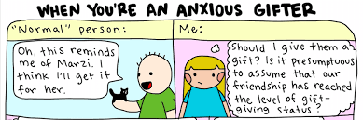



Business Development

Slide 4
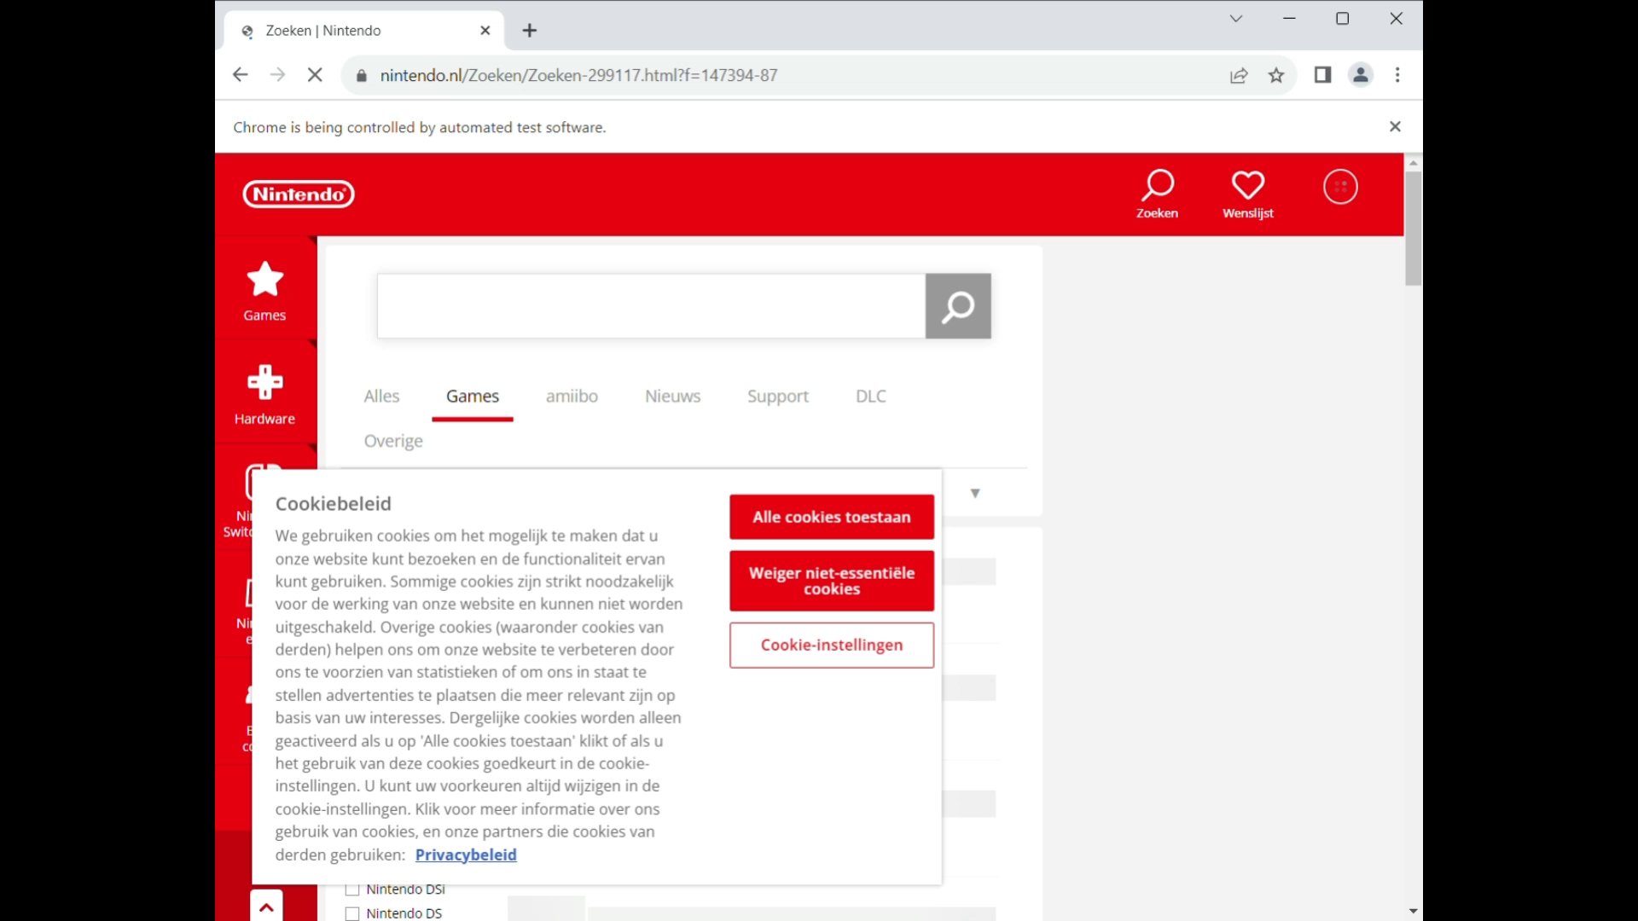
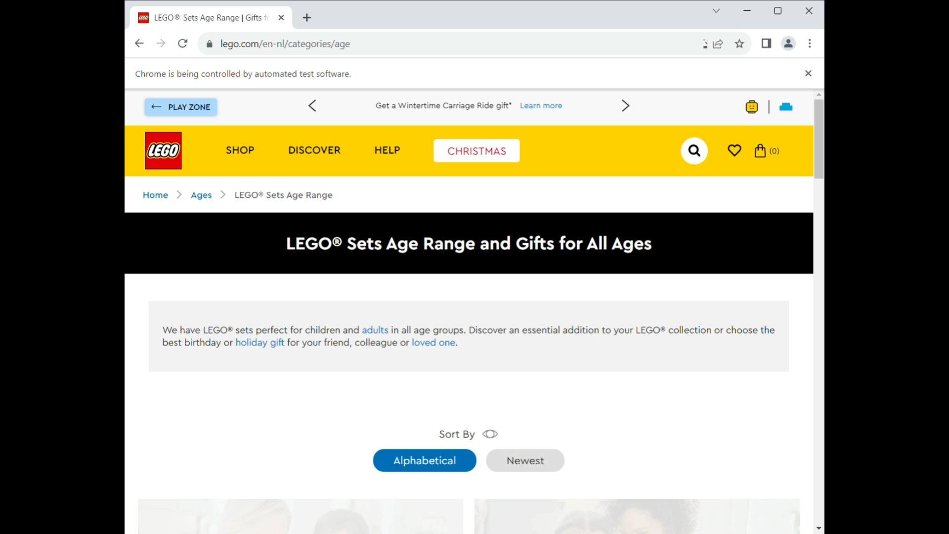
Technical Approach & Demonstration
Selenium
Beautiful Soup
Streamlit
Web page: demo

Slide 5
Future Improvement
Wider range of products
Linking to the original website
Third bullet point here

